Slide 1
Do now
Definition revision
Term | Definition
 | Term used to describe the participants selected in the study
 | Term used to describe the larger group of people that the study is interested in the results referring to
 | The term to make a variable specific and measurable
 | The group that receives the independent variable in experimental research
 | The variable that is changed and manipulated in the experiment
 | The variables that is controlled for so it does not impact results
 | The group that does not receive the independent variable in experimental research
Reminders:
Phones away
Bags on floor
Books out
Pens out
Whiteboard
Reminders
Assessment reminder: Test Friday

Slide 2

Answers
Term | Definition
Sample | Term used to describe the participants selected in the study
Population | Term used to describe the larger group of people that the study is interested in the results referring to
Operationalise | The term to make a variable specific and measurable
Experimental group | The group that receives the independent variable in experimental research
Independent variable | The variable that is changed and manipulated in the experiment
Extraneous variable | The variables that is controlled for so it does not impact results
Control group | The group that does not receive the independent variable in experimental research

Slide 3
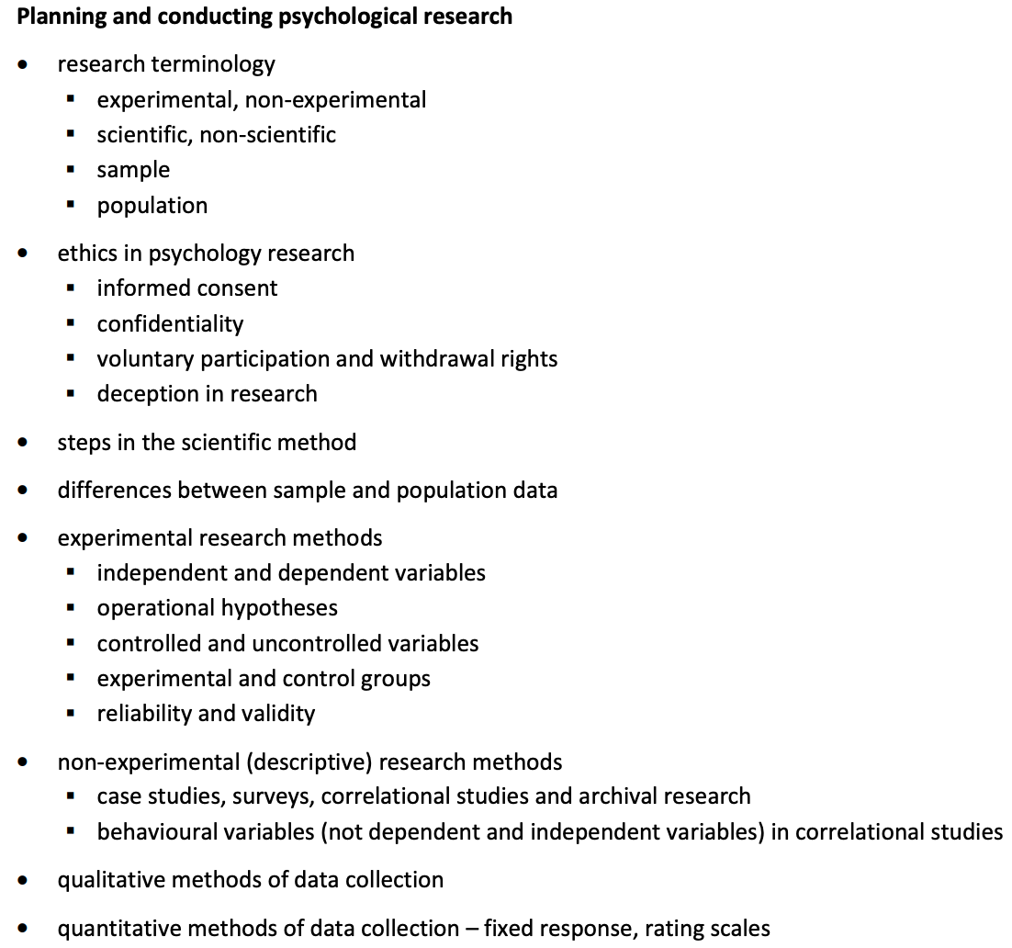
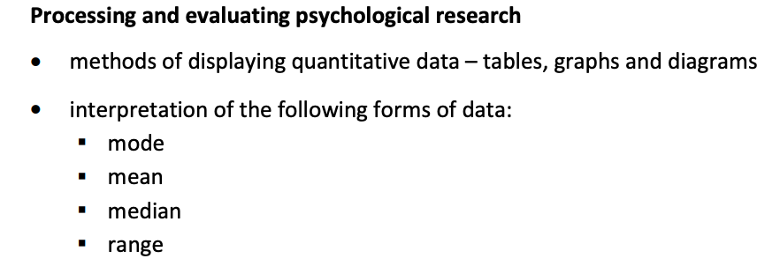

Research Methods
Syllabus points covered today:
Reminders
Assessment: Friday

Slide 4

Learning Intention
By the end of the lesson I will be able to:
Measures of central tendencies
Measures of dispersion
Summarising v interpreting data
Quantitative v Qualitative - evaluating
Success Criteria
Everyone
Completed the independent and dependent variable activities
Completed the lego game activity

Slide 5
THINK PAIR SHARE
What does the term measure of central tendancy mean. List the ones you know
What does the term measure of dispersion mean. List the one syou know.

Slide 6
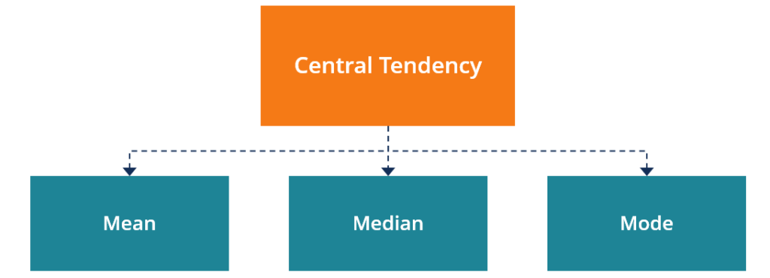
Measures of Central Tendencies
LO: Compare measures of central tendancies
Vocabulary
Outliers: an observation that lies an abnormal distance from other values in a data set Quantitative data: information about quantities, and therefore numbers
Concept Development
All these of these are used to describe the central points in quantitative data.
This allows researchers to summarise and compare data easily.
Checking for understanding
Which one of these is impacted by outliers? What do these three descriptive statistics have in common?

Slide 7
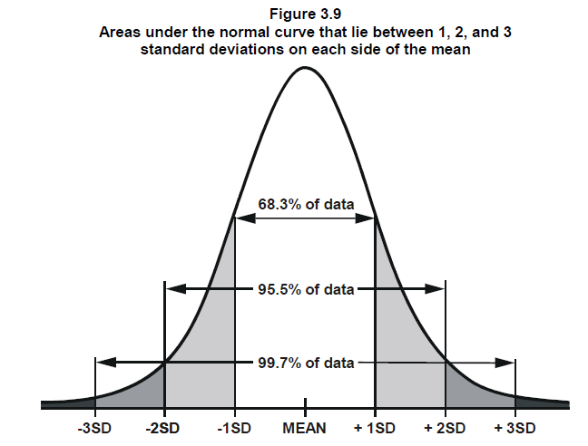
Dispersion
Range
Standard Deviation
Measures of Dispersion
LO: Explain the process of neural transmission (3.3)
Vocabulary
Dispersion: how spread apart the data is
Measures of dispersion describe the spread of data around a central value (mean, median or mode),
Range:
Higher value minus the lowest value
Standard Deviation (SD or σ):
How far away values are from the mean
Both the range and SD show that how far apart the data set is in different ways
Concept Development

Slide 8
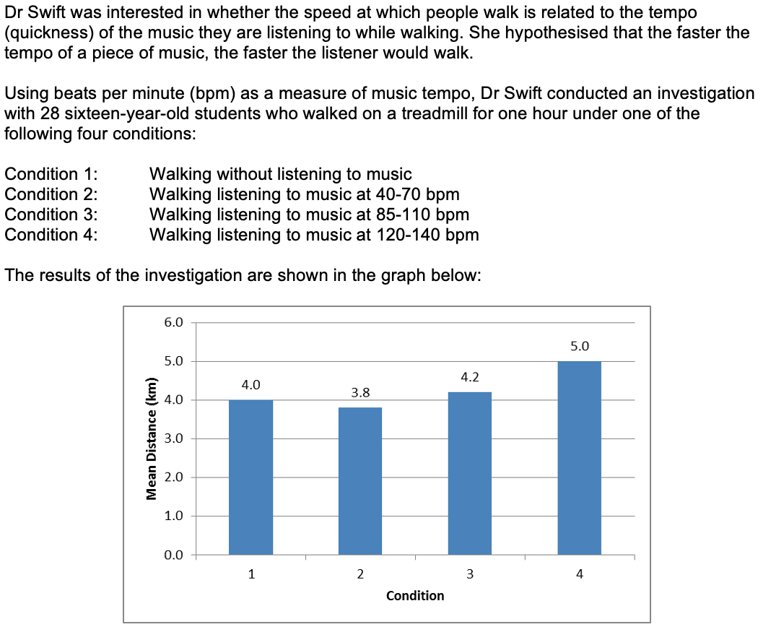
Activate prior knowledge
Read the scenario.
Describe the findings of the scenario (3)
Interpret the findings and outline the conclusions that can be drawn (3)

Slide 9
LO: Summarising v interpreting data
Summarising vs Interpreting data
Vocabulary
Dispersion: how spread apart the data is
Command terms and possible exam questions:
“Summarise the findings”
“Describe the trends”
“Describe the spread of data / findings”
“Compare the results from each group”
Command terms and possible exam questions:
“Interpret the results collected”
“Outline the conclusions from the study"
”State whether the hypothesis was accepted or rejected”
Concept Development
From the question on previous slide:
A perfect response example:
Group 4 walked the furthest (5 km) while listening 120 – 140 bpm (1)
Group 2 walked the shortest distance at 3.8km while listening to music at 40 – 70 bpm (1)
The control group listening to no music walked 4km (1)
3 marks = 3 descriptors
1 mark deducted for interpretation or mentioning hypothesis
From the question on previous slide:
Dr. Swift can accept the hypothesis that the faster a tempo the faster an individual will walk (1)
This means that… (1)
This can be seen through the group 4 who walked 5km with the fastest bpm compared to all over slower tempos of music and the control (1)
3 marks = 3 descriptors
Always back your interpretation to data
Always back it with data that proves your conclusion

Slide 10
THINK PAIR SHARE
When is a bar graph used vs a histogram vs a line graph vs a scatterplot?
Graphs are worth 5 marks in exams and tests – what do you need to include?

Slide 11
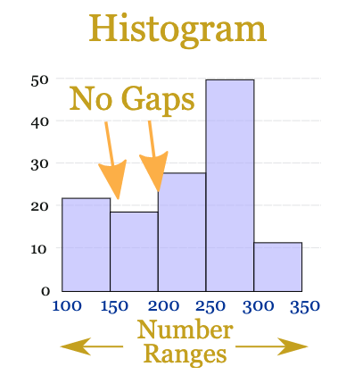
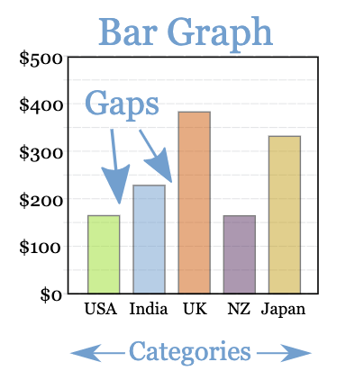
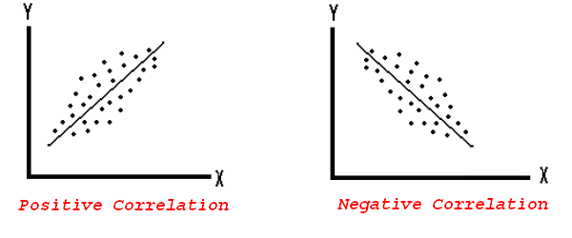
Bar Graph
Constructing your graph
A title that includes both variables
Labeled axes with units
Y axis ( up / down) always shows the dependent variable (the one being measured)
X axis (left / right) always shows the independent variable (the one being manipulated / changed)
Histogram
Scatterplot
Used when looking at the frequency of ONE numerical data set (i.e one variable that can be measured)
Used when there is ONE numerical data set and ONE categorical data set that you are measuring the relationship between
Used when there are TWO continuous data sets that you are measuring the relationship between

Slide 12
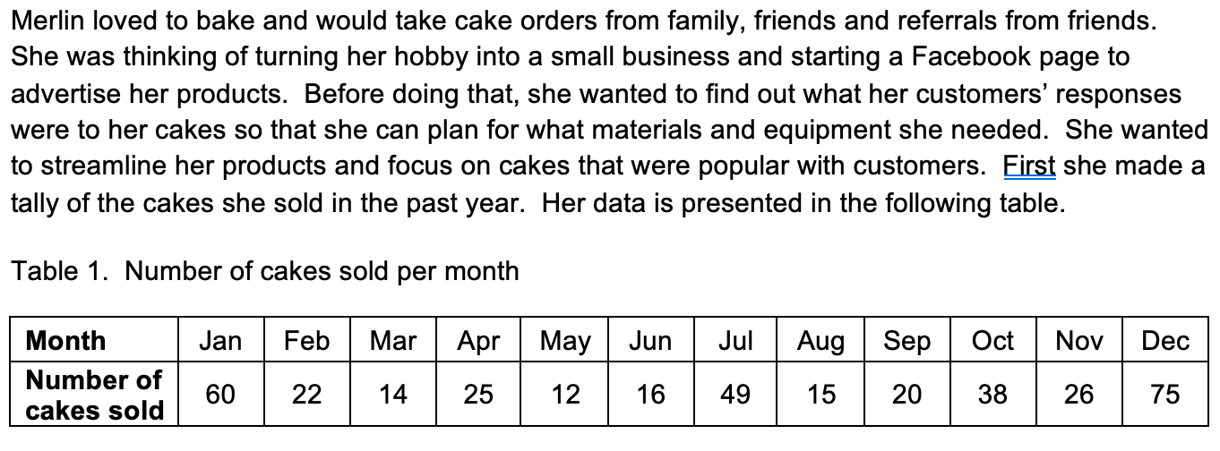
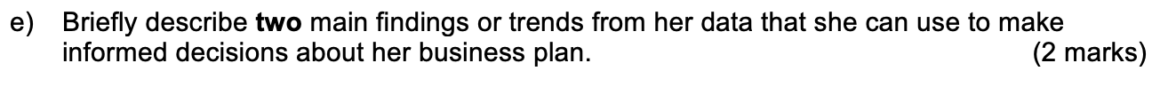
Independent practice

Slide 13
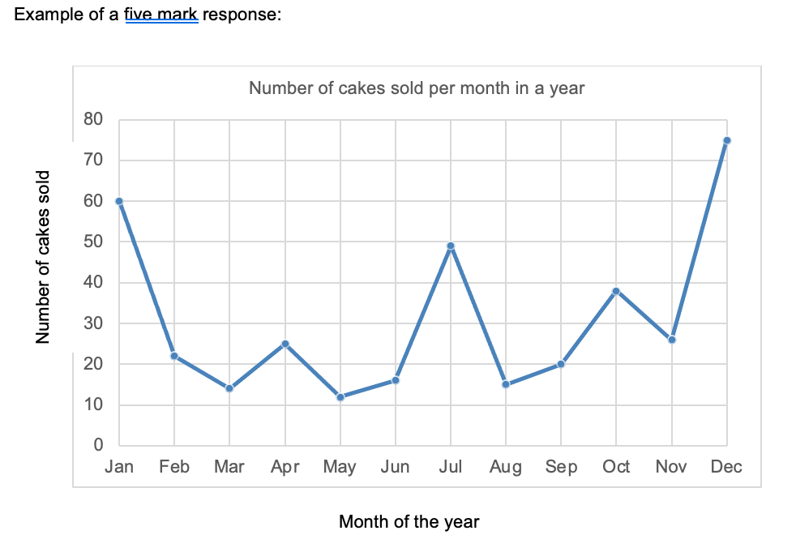
Tips:
Always figure out the type of data first.
Each data type will be better represented by different graphs.
If you are unsure: it is ONLY one mark – still attempt the graph as the rest (title, labels plotting is easy marks)
Independent practice
Check your understanding
What is the

Slide 14
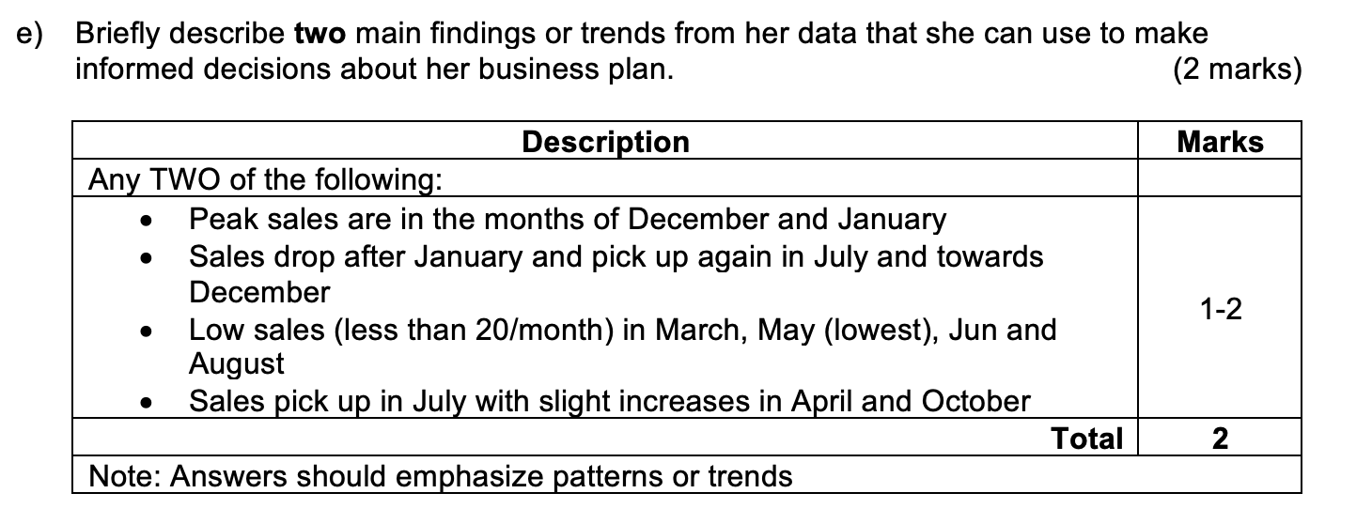
Independent practice

Slide 15




Research Methods revision
Syllabus points:
Task
Choose a topic and…
Revise
Relearn or
Test and practice

Slide 16
Revision step 1: Identify areas of strength and weakness – use the checklist on SEQTA
Steps to revision:
Look at the syllabus points you need to cover
Colour code them: highlight in red the areas you do not know well, yellow for rusty and green for confident
If the syllabus item is in red: you need to relearn material
If the syllabus item is in yellow: you need to revise the material
If the syllabus item is in green: you need to test and practice the material
Skill Development
Task: Open the syllabus review document on SEQTA and start colour coding the items under: biological influence and research methods.
The following slides will teach you how to relearn, revise and how to test and practice

Slide 17
Tips for relearning
Vocabulary
Define:
Sometimes it takes a number of times for information to stick, this can vary day to day and topic to topic. Therefore making sure you are consistent and regular with your revision.
Relearning involves:
trying to recall the information you know first
then filling in the gaps in knowledge that you have
Using a strategy to take down info: mindmap, graphic organizer, flashcards, Cornell notes etc.
Most importantly: time, be consistent and have a study schedule to go over content covered in class
Going home and testing yourself with the check for understanding boxes (bottom right of most slides) on Ms. Davey’s slides is a good starting point; only read the check for understanding box, answer on paper or verbally, then check if your answer missed details or key words by checking the slides.
Skill Development
Checking for understanding
Summarise Define Explain

Slide 18
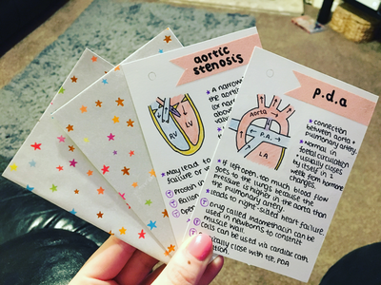
Strategy: Revising
LO: Explain the process of neural transmission (3.3)
Memories in the long-term memory last better when they are rehearsed through elaborative rehearsal: when they are linked to information that you already know!
Vocabulary
Define:
Skill Development
Revision strategy examples and what they are good for:
Flashcards: definitions, theories, key words
Narratives and visuals: when you find info hard to understand / remember
Acronyms: Remembering information that has to be in a a specific order
Mindmaps: great for topic overviews
General tips:
Make it visual: pictures, tables, diagrams, headings and subheadings. Memory works better visually and this makes it easier to go over notes when you need them for exams
Colours: Also can be used to colour code: one colour for – definitions, evaluations, theorist names,
Get someone to test you
Stay consistent with even when you think you know it well
More ideas on revision techniques:
Click me for general tips
Click me on how to for mindmapping, flashcards etc
Click me for what elaborative rehearsal is

Slide 19
Strategy: Test and practice
LO: Explain the process of neural transmission (3.3)
The best way to test what you know is to create and practice test / exam questions. This is why teachers know their subjects so well.
Choose a topic and come up with short answer style questions on that topic.
Tips:
1.Remember to use the same wording as in a test / exam (common command terms found on SEQTA)
2. Pay attention to mark allocation
3. Be specific when making your marking key – what key words would be in the answer
4. Swap tests with a friend
This can also be done in a multiple choice format or extended response format.
Skill Development

Slide 20
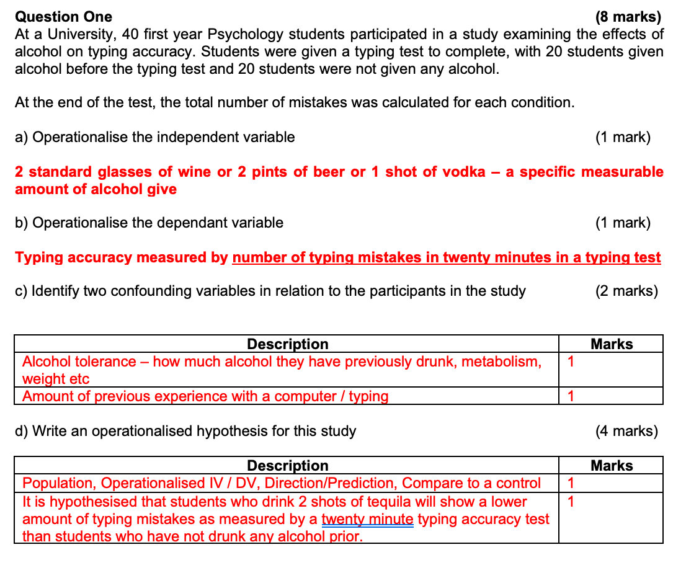
Test and practice example
LO: Explain the process of neural transmission (3.3)
Skill Development

Slide 21

Exit Ticket
Ask one get one

